Slide 1


DNS and Web Domain Hosting Website
IGATE is now a part of Capgemini

Slide 2
TEAM MEMBERS
Pratibha Babaji Thosar
Poojan Sethi
Pooja Shinde
Parth Doshi
Pallavi Band

Slide 3
OVERVIEW OF THE PROJECT
DNS : The Domain Name System(DNS) is the phonebook of the internet
Web Hosting : Web Hosting is a service that allows organizations and individuals to post a website or web page onto the internet.
Seiretto – Web Domain and Hosting
Seiretto is a Web Hosting website that has a growing list of GOV.UK and AC.UK domains.
The website allows you to check for a particular domain name availability and buy the same.

Slide 4
Actors

Slide 5
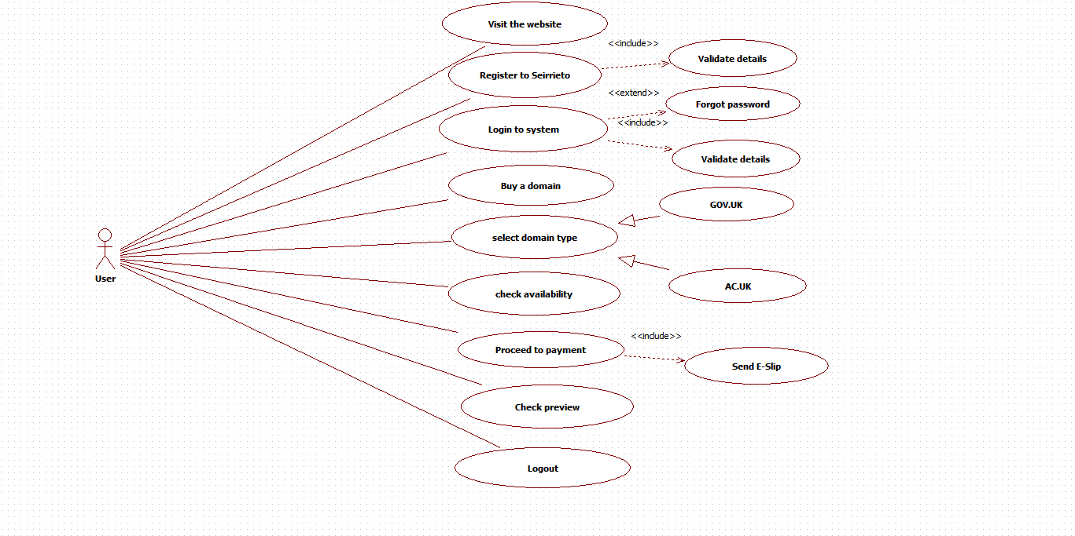
Use Cases
Flow Use Case:

Slide 7
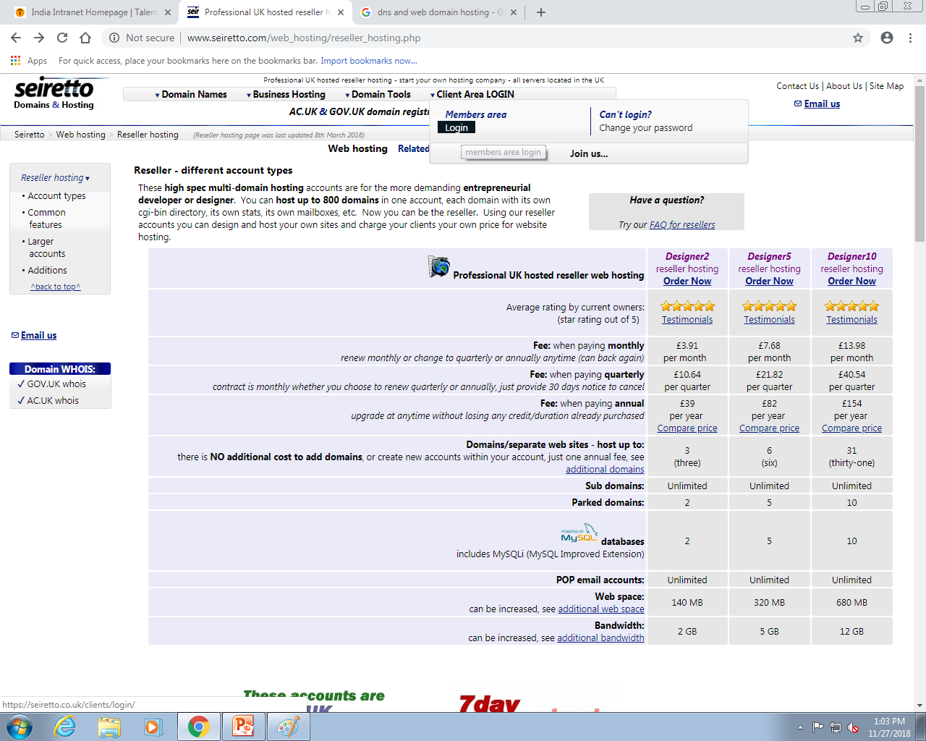
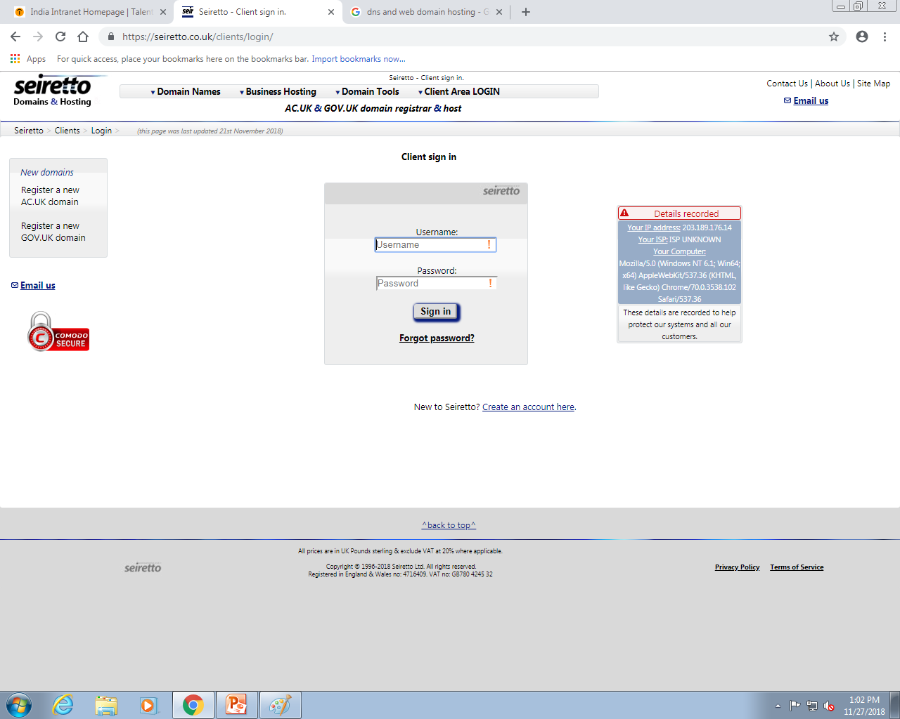
Steps to buy a domain:
1. Login :

Slide 8
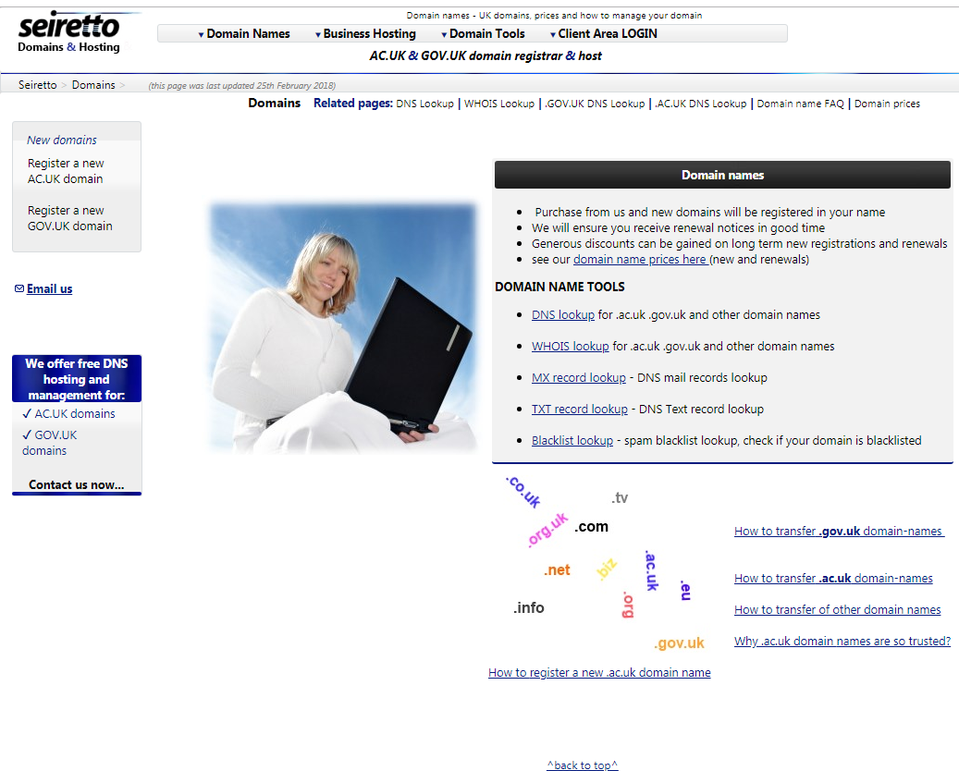
2. Register for GOV.UK or AC.UK domain

Slide 9
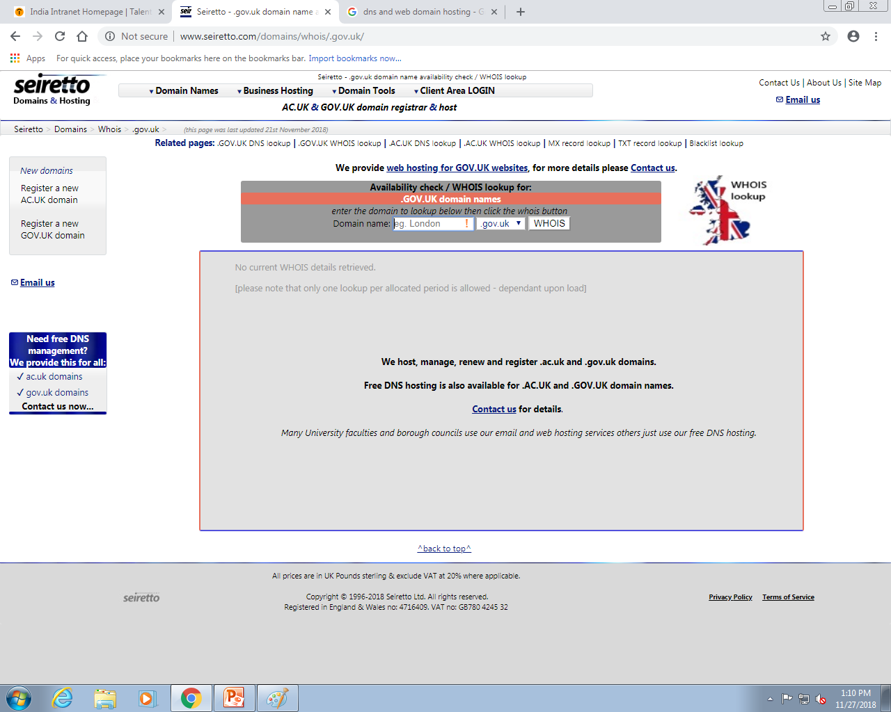
3. Check Domain Availability

Slide 10
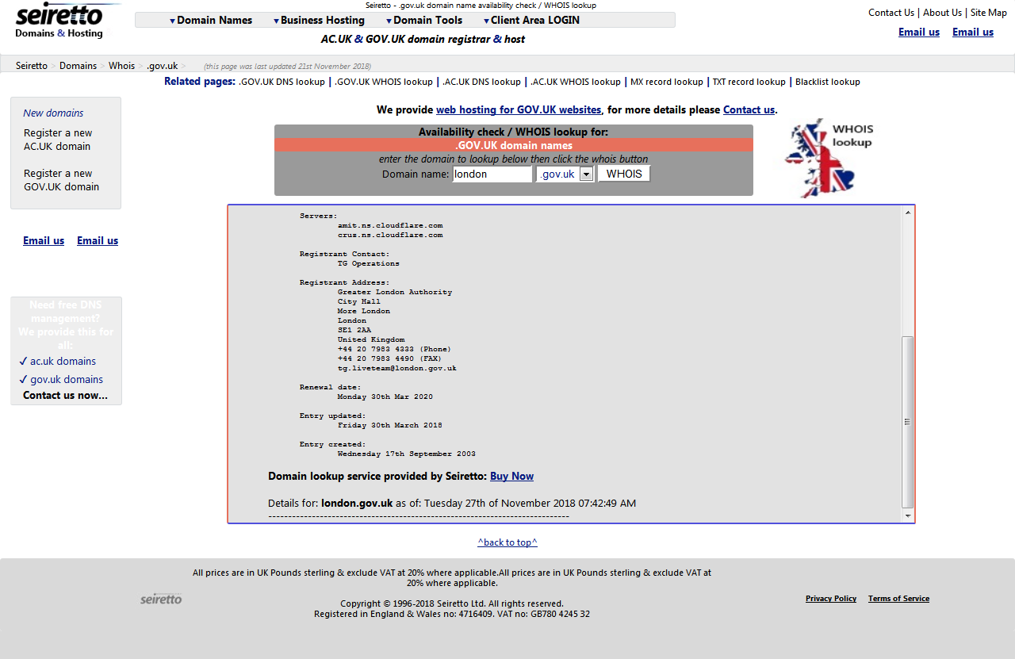
4. When Domain is available

Slide 12
TEST CASES
A TEST CASE is a set of conditions or variables under which a tester will determine whether a system under test satisfies requirements or works correctly. The process of developing test cases can also help find problems in the requirements or design of an application.
The Link to our test cases of the application is :

Slide 13
Defect Report
DEFECT REPORT is a document that identifies and describes a defect detected by a tester. The purpose of a defect report is to state the problem as clearly as possible so that developers can replicate the defect easily and fix it.
The link to the defect report of our project is :

Slide 14
Application link
http://www.seiretto.com/web_hosting/reseller_hosting.php

Slide 15
Traceability Matrix

Slide 16
Conclusion
After going through the website, we got to see that a lot of modules are left incomplete and some of them are not functioning as desired.
Hence improvement is needed for the application to function as per the requirements.

Slide 17
Thank You

